Slide 1
Chapter 4 : Software Project Management
Juthawut Chantharamalee
Curriculum of Computer Science
Faculty of Science and Technology, Suan Dusit University
Email: jchantharamalee@yahoo.com
URL: http://dusithost.dusit.ac.th/~juthawut_cha/home.htm

Slide 2
Outline of this presentation
Introduction
Management Approach
Team Approach
Critical Practices
Capability Maturity Model
Personal Software Process
Reference to Chapter 1 of “Software Engineering with Schaum’s Out Line”, McGraw-Hill, 2002.

Slide 3
Outline of this presentation (Cont.)
Earned Value Analysis
Error Tracking
Postmortem Reviews
Reference to Chapter 1 of “Software Engineering with Schaum’s Out Line”, McGraw-Hill, 2002.

Slide 4
4.1 Introduction
Software project management is the important task of planning, directing, motivating, and coordinating a group of professionals to accomplish software development. Software project management uses many concepts from management in general, but it also has some concerns unique to software development. One such concern is project visibility.

Slide 5
4.2 Management Approaches
A basic issue in software project management is whether the process or the project is the essential feature being managed. In process-oriented management, the management of the small tasks in the software life cycle is emphasized.

Slide 6
4.3 Team Approaches
Organizing a group of people into an efficient and effective team can be a difficult task. Letting a team develop its own paradigm can be risky. Choosing a team organization based on the project and the team members may help avoid disaster.

Slide 7
4.3 Team Approaches
Some teams consist of people with similar skills. These teams often stay together through many projects. Other teams are composed of people with different expertise that are grouped into a team based on the need for specific skills for a project. This is often called a matrix organization.

Slide 8
4.3.1 CHIEF PROGRAMMER TEAMS
IBM developed the chief programmer team concept. It assigns specific roles to members of the team. The chief programmer is the best programmer and leads the team. Nonprogrammers are used on the team for documentation and clerical duties. Junior programmers are included to be mentored by the chief programmer.

Slide 9
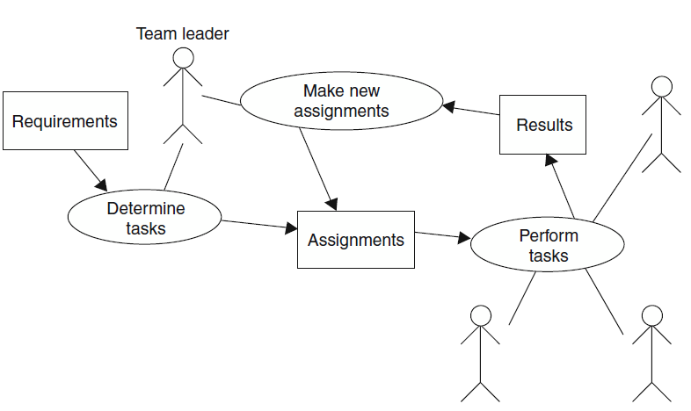
Example-1
Fig. 4-1. High-level process model for hierarchical team structure.

Slide 10
4.4 Critical Practices
Most studies of software development have identified sets of practices that seem critical for success. The following 16 critical success practices come from the Software Project Managers Network

Slide 11
Sets of practices that seem critical for success
Adopt continuous risk management.
Estimate cost and schedule empirically.
Use metrics to manage.
Track earned value.
Track defects against quality targets.
Treat people as the most important resource.
Adopt life cycle configuration management.1
Manage and trace requirements.

Slide 12
Sets of practices that seem critical for success
9. Use system-based software design.
10. Ensure data and database interoperability.
11. Define and control interfaces.
12. Design twice, code once.
13. Assess reuse risks and costs.
14. Inspect requirements and design.
15. Manage testing as a continuous process.
16. Compile and smoke-test frequently..

Slide 13
Example-2
The IT manager of company WRT needs a software process that will aid his inexperienced software developers in successful software development. The manager uses the best-practices list to ensure that his software process will include important activities.

Slide 14
Example-2 (Practice 1)
Adopt continuous risk management. The manager includes process steps throughout the life cycle in which the possible risks are identified and evaluated, and tasks are included to ameliorate the risks.

Slide 15
Example-2 (Practice 2)
Estimate cost and schedule empirically. The manager includes a process step to estimate the costs at the beginning of the life cycle and steps to reestimate the costs throughout the life cycle. Steps include archiving the data to be used for future estimation.

Slide 16
Example-2 (Practice 3)
Use metrics to manage. The manager chooses metrics and includes steps for metric recording and steps for evaluating progress based on the metrics.
Example-2 (Practice 4)
Track earned value. The manager includes steps to calculate earned value (see below) and to post the calculations.

Slide 17
Example-2 (Practice 5)
Track defects against quality targets. The manager establishes goals for the number of defect reports that are received. Process steps for posting the number of defect reports are included.
Example-2 (Practice 6)
Treat people as the most important resource. The manager reviews the whole software process to consider the impact on the programmer.

Slide 18
Example-2 (Practice 7)
Adopt life cycle configuration management. The manager includes in the process the use of a configuration management tool for all documents and includes process steps to enter all documents and changes into the configuration management tool.

Slide 19
Example-2 (Practice 8)
Manage and trace requirements. The manager includes process steps to acquire the requirements from the user and steps to trace each requirement to the current phase of development.
Example-2 (Practice 9)
Use system-based software design. The manager includes steps to ensure a system-based design.

Slide 20
Example-2 (Practice 10)
Ensure data and database interoperability. The manager includes steps to check for interoperability between the data and the database.
Example-2 (Practice 11)
Define and control interfaces. The manager includes steps to define and baseline the interfaces.

Slide 21
Example-2 (Practice 12)
Design twice, code once. The manager includes design review steps.
Example-2 (Practice 13)
Assess reuse risks and costs. The manager includes steps to identify areas of potential reuse and steps to assess costs and risks.

Slide 22
Example-2 (Practice 14)
Inspect requirements and design. The manager includes inspection steps in both the requirements and design phases.
Example-2 (Practice 15)
Manage testing as a continuous process. The manager includes testing steps in all phases.

Slide 23
Example-2 (Practice 16)
Compile and smoke-test frequently. The manager includes frequent testing steps in the implementation phase.

Slide 24
4.5 Capability Maturity Model
The Software Engineering Capability Maturity
Model (SE-CMM) is used to rate an organization’s software development process. An assessment of an organization’s practices, processes, and organization is used to classify an organization at one of the following levels:

Slide 25
4.5 Capability Maturity Model
The Software Engineering Capability Maturity
Model (SE-CMM) is used to rate an organization’s software development process. An assessment of an organization’s practices, processes, and organization is used to classify an organization at one of the following levels:

Slide 26
An assessment of an organization’s practices
Level 1: Initial—This is the lowest level and usually characterized as chaotic.
Level 2: Repeatable—This level of development capability includes project tracking of costs, schedule, and functionality. The capability exists to repeat earlier successes.

Slide 27
An assessment of an organization’s practices
Level 3: Defined—This level has a defined software process that is documented and standardized. All development is accomplished using the standard processes.
Level 4: Managed—This level quantitatively manages both the process and the products.
Level 5: Optimizing—This level uses the quantitative information to continuously improve and manage the software process.

Slide 28
4.6 Personal Software Process
Watts Humphrey2 has developed the Personal Software Process to improve the skills of the individual software engineer. His approach has the individual maintain personal time logs to monitor and measure the individual’s skills. One result of this is measuring an individual’s productivity.

Slide 29
4.6 Personal Software Process (cont.)
The usual measure of productivity is lines of code produced per day (LOC/day). Additionally, errors are timed and recorded. This allows an individual to learn where errors are made and to
assess different techniques for their effect on productivity and error rates. Additionally, the productivity can be used to evaluate the reasonableness of
proposed schedules.

Slide 30
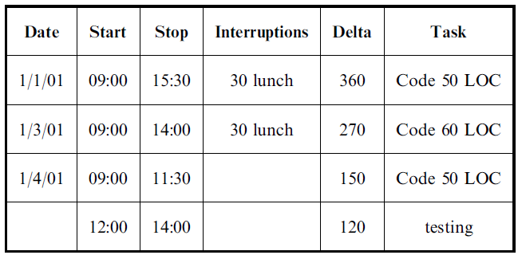
Example 3
Programmer X recorded this time log.

Slide 31
4.6 Personal Software Process (cont.)
The programmer spent 360 + 270 + 150 + 120 = 900 minutes to write and test a program of 160 LOC. Assuming 5 hours per day (300 minutes/day), X spent effectively 3 days to program 160 LOC. This gives a productivity of 53 LOC/day. When X’s manager schedules a week to code a 1000 = LOC project, X is able to estimate that the project will take about 4 weeks.

Slide 32
4.7 Earned Value Analysis
One approach to measuring progress in a software project is to calculate how much has been accomplished. This is called earned value analysis. It is basically the percentage of the estimated time that has been completed. Additional measures can be calculated. Although this is based on estimated effort, it could be based on any quantity that can be estimated and is related to progress.

Slide 33
4.7.1 BASIC MEASURES
1. Budgeted Cost of Work (BCW): The estimated effort for each work task.
2. Budgeted Cost of Work Scheduled (BCWS): The sum of the estimated effort for each work task that was scheduled to be completed by the specified time.
3. Budget at Completion (BAC): The total of the BCWS and thus the estimate of the total effort for the project.

Slide 34
4.7.1 BASIC MEASURES (Cont.)
4. Planned Value (PV): The percentage of the total estimated effort that is assigned to a particular work task; PV = BCW/BAC.
5. Budgeted Cost of Work Performed (BCWP): The sum of the estimated efforts for the work tasks that have been completed by the specified time.
6. Actual Cost of Work Performed (ACWP): The sum of the actual efforts for the work tasks that have been completed.

Slide 35
4.7.2 POGRESS INDICATORS
Earned Value (EV) = BCWP/BAC
= The sum of the PVs for all
completed work tasks
= PC = Percent complete
Schedule Performance Index(SPI) = BCWP/BCWS
Schedule Variance (SV) = BCWP BCWS
Cost Performance Index(CPI) = BCWP/ACWP
Cost Variance (CV) = BCWP ACWP

Slide 36
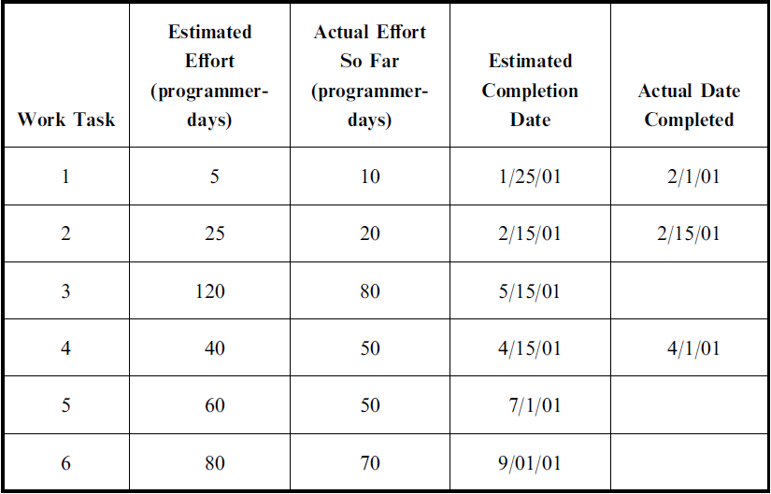
Example 4
Company LMN is partway through its project. The job log below indicates the current status of the project.

Slide 37
Explain-1
The BAC is the sum of the estimations. BAC = 330 days. BAC is an estimate of the total work. On 4/1/01, tasks 1,2, and 4 have been completed. The BCWP is the
sum of the BCWS for those tasks. So BCWP is 70 days. The earned value (EV) is 70/330, or 21.2 percent. On 4/1/01 tasks 1 and 2 were scheduled to be completed
and 1,2, and 4 were actually completed.

Slide 38
Explain-2
So BCWP is 70 days and BCWS is 30 days. Thus, SPI is 70/30, or 233 percent. The SV = 70 days 30 days = +40 days, or 40 programmer-days ahead. The ACWP is the sum of actual effort for tasks 1, 2, and 4. So, ACWP is 80 programmer-days. CPI is 70/80 = 87.5 percent. The CV = 70 programmer-days 80 programmer-days = 10 programmer-days, or 10 programmer-days behind.

Slide 39
4.8 Error Tracking
One excellent management practice is error tracking, which is keeping track of the errors that have occurred and the inter-error times (the time between occurrences of the errors). This can be used to make decisions about when to release software.

Slide 40
4.8 Error Tracking
An additional effect of tracking and publicizing the error rate is to make the software developers aware of the significance of errors and error reduction. The effects of changes in the software process can be seen in the error data. Additionally, making the errors and error detection visible encourages testers and developers to keep error reduction as a goal.

Slide 41
Example 5
Consider the following error data (given as the times between errors): 4, 3, 5, 6, 4, 6, 7. The instantaneous error rates are the inverses of the inter-error times: 0.25, 0.33, 0.20, 0.17, 0.25, 0.17, and 0.14. Plotting these against error number gives a downward curve, as shown in Figure 3-2. This suggests that the actual error rate is decreasing.

Slide 42
Example 5
Fig. 4-2. Plot of error rates.

Slide 43
4.9 Postmortem Reviews
One critical aspect of software development is to learn from your mistakes and successes. In software development, this is called a postmortem. It consists of assembling key people from the development and the users groups. Issues consist of quality, schedule, and software process. It is important that everyone feel free to express opinions. A formal report needs to be produced and distributed. The reports should not be sanitized.

Slide 44
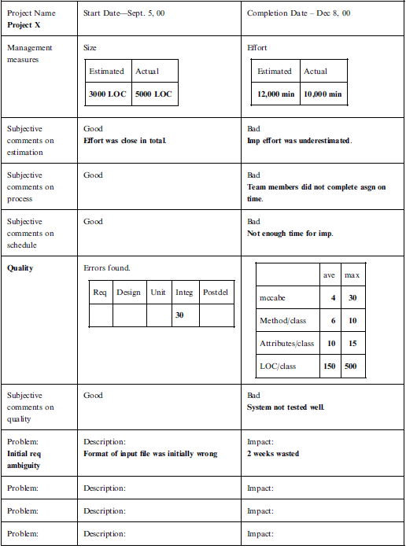

Slide 45
Chapter 4: The End (Any Question?)

